Slide 1
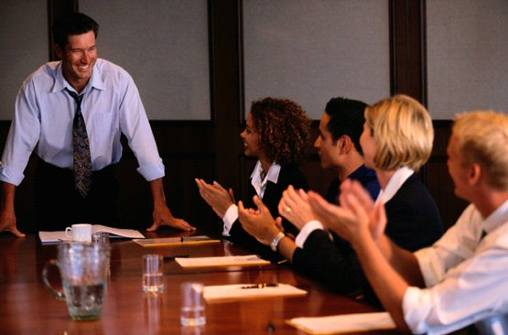
Public Speaking and
Oral Communication
CHAPTER FIFTEEN

Slide 2
Overview
Selection of the Topic
Preparation of the Presentation
Determination of the Presentation Method
Consideration of Personal Aspects
Audience Analysis
Appearance and Physical Actions
Use of Voice
Use of Visuals (Graphics)
Team (Collaborative) Presentations
Reporting Orally

Slide 3
Formal Speeches:
Determination of the Topic
It may be assigned.
You may have to selected it.

Slide 4
If It Is Assigned
Probably it is because of your expertise on the topic.
The situation may assign it, such as
  a welcome address,
  an honors award, or
  a charity drive.

Slide 5
If You Must Select
Be guided by
  your background and knowledge,
  the audiences interests, and
  the occasion of the speech.

Slide 6
Then Prepare.
Gather the information needed (libraries, files, Internet, interviews).
Next, organize.
  Introduction
  Body
  Conclusion

Slide 7
Introduction
Prepares listeners to receive message
Arouses interest

Slide 8
Some Opening Strategies
Give a human interest story.
Pose an unanswered question.
Present a surprise statement.
Give a startling statistic.
Use appropriate humor.
Quote a recognized expert.
Appeal to solve a common problem.

Slide 9
Body
Divide the whole into comparable parts.
Apply conventional relationships of data (time, place, quantity, factor, combination).
Use factors for presenting issues and questions.
Connect major points with transitions.

Slide 10
The Conclusion, Ending
Consider
  Restating the subject.
  Summarizing key points.
  Stating that conclusion – the climactic ending.

Slide 11
Presentation Methods
Extemporaneous – from notes, rehearsed
Memorized – the most difficult, hazardous
Reading – typically dull, mechanical

Slide 12
Consideration of Personal Aspects
Confidence – gained by
  Preparing well
  Dressing appropriately
  Talking strong
Sincerity – try to project it
Thoroughness – scant, hurried presentations are obvious
Friendliness – make genuine

Slide 13
Audience Analysis
Preliminary – Determine size, characteristics (education level, sex, age, etc.)
  Then adapt.
During presentation – Get feedback (smiles, frowns, blank stares, applause)
  Then adjust during speech.

Slide 14
Appearance and Physical Action
The communication environment – the things that surround you as you speak
Your appearance – how they see you is part of the message.
Your posture – also communicates
So does your walking – to and from the podium, during speech
Also, your facial expressions (smiles, eye movements, frowns)
Likewise, the your gestures – vague in meaning, but they communicate

Slide 15
Use of Voice
Vary Pitch.
Change Speaking Speed.
Use Vocal Emphasis.
Develop Pleasant Voice Quality.
Improve Through Self-Analysis and Imitation.

Slide 16
Selection of Visuals
Design – select what simplifies, communicates the complex
Types – know them all, for the one occasion
Audience size, cost, ease of preparation – consider all

Slide 17
Media Options
Media
Image Quality
Audience Size
Cost
Ease of Preparation
Nonprojected
Poster
Flip chart
Presentation board
Real object or model
Chalkboard or white board
Photos
Handouts
Very good
Good
Good
Very good
Fair
Very good
Excellent
Small
Small
Small
Small
Medium
Medium
Large
$$
$
$
$-$$$$
$
$$]
$-$$
Medium
Short
Short
Short to long
None
Short to medium
Short to long
Projected
35m slides
Overhead transparencies
Visual presenters
TVs/VCRs
Computer projection
Very good
Very good
Very good
Excellent
Good
Large
Medium
Medium
Medium to large
Medium to large
$
$
None
$-$$$$
None
Medium
Short
None
Short to long
Short to long

Slide 18
Techniques of Using Visuals
Make certain that everyone in the audience can see the visuals.
Explain the visuals if necessary.
Organize and plan the use of each visual.
Emphasize the visuals.
Talk to the audience--not the visuals.
Avoid blocking the listeners’ view of the visuals.

Slide 19
Team Presentations
Plan to incorporate ideas on individual speeches and collaborative writing.
Plan order and content.
Plan physical factors.
Plan staging.
Plan closing and Q & A session.
Plan to rehearse presentation.

Slide 20
Oral Reports
Definition
Differences Between Oral and Written Reports
  Visual Advantages of Written Word
  Reader Control of Written Presentation
  Emphasis on Correctness in Writing

Slide 21
Preparing the Oral Report
Determine objective – as in written reports
Organize – as in written reports
  But indirect order dominates.
  Conclude, as in written reports

Slide 22
“It usually takes more than three weeks to prepare a good impromptu speech.”
-- Mark Twain

